Slide 1
SOC PLATFORM ARCHITECTURE
From Monitoring to Intelligent Security Operations
A Three-Phase Implementation — Monitoring · Cloud · Intelligence
2026

Slide 2
EXECUTIVE OVERVIEW
01
02
03
04
05
PROBLEM & GOALS
MONITORING FOUNDATION
CLOUD INFRASTRUCTURE
BACKEND INTELLIGENCE
SUMMARY & OUTCOMES
Security operations gaps, project objectives, and strategic outcomes
Visibility layers, security tools, architecture, and deployment
Alert pipeline, AI engine, approval workflows, and remediation
Complete platform capabilities and delivered value
Huawei Cloud deployment, ECS architecture, and security groups
02

Slide 3
01
PROBLEM & GOALS
Why this platform exists and what it aims to achieve
03

Slide 4
PROBLEM & GOALS
THE PROBLEM — SECURITY OPERATIONS GAPS
FRAGMENTED VISIBILITY
RAW DATA OVERLOAD
PASSIVE RESPONSE
Organizations watch only one layer — network OR host OR runtime — creating dangerous blind spots attackers exploit.
SIEMs collect massive unstructured technical data. Analysts drown in alerts without context, correlation, or prioritization.
Most SOC platforms only detect and display alerts. Correlation, investigation, and remediation remain entirely manual.
The Result: Slower incident response, missed multi-stage attack patterns, and analyst burnout from manual correlation across disconnected tools.
04

Slide 5
PROBLEM & GOALS
PROJECT GOALS & OBJECTIVES
1
COMPLETE VISIBILITY
Monitor network, host, runtime, and infrastructure layers in one unified stack. No blind spots. Every critical layer observed, collected, and centralized.
2
INTELLIGENT PROCESSING
Transform raw alerts into enriched, correlated incidents with AI-powered analysis. From data overload to actionable intelligence.
3
CONTROLLED RESPONSE
Automate investigation, playbook generation, approval workflows, and Ansible-based remediation with full audit trails. The platform thinks before it acts.
05

Slide 6
02
PHASE 1: MONITORING FOUNDATION
Building the visibility backbone of the SOC platform
06

Slide 7
PHASE 1 — MONITORING
VISIBILITY LAYERS & SECURITY TOOLS
Key Idea: Before any SOC logic can exist, the system must see everything — network, host, runtime, and resources.
Layer | Tool | Role
Network | Suricata | Traffic, packets, protocols, IDS alerts
Host / Endpoint | Wazuh | Auth events, file integrity, agent alerts
Runtime | Falco | Process behavior, syscalls, containers
Infrastructure | Telegraf | CPU, RAM, disk, load, system health
Collection | Filebeat | Log shipping and forwarding to Elasticsearch
Collection | Falcosidekick | Falco alert forwarding
Analysis | Elasticsearch | Storage, indexing, search, centralization
Visualization | Kibana | Dashboards, monitoring, analysis
07

Slide 8
PHASE 1 — MONITORING
ARCHITECTURE & DATA FLOW
SOURCES → COLLECTION → ELASTICSEARCH → KIBANA
SECURITY SOURCES
COLLECTION LAYER
SIEM CORE
VISUALIZATION
System Logs
Auth Logs
Suricata IDS
Wazuh HIDS
Falco Runtime
Telegraf Metrics
Filebeat
Reads and ships logs
Falcosidekick
Receives Falco alerts
Telegraf → ES
Direct metrics feed
Elasticsearch
Central storage, search, indexing
9200 HTTPS
Receives all data streams: Filebeat, Falcosidekick, Telegraf
Kibana
Dashboards
Monitoring
Analysis
5601 HTTPS
08

Slide 9
PHASE 1 — MONITORING
DEPLOYMENT, SETUP & REQUIREMENTS
HARDWARE REQUIREMENTS
SERVICE DEPLOYMENT
Level | CPU | RAM | Disk
Minimum | 4 cores | 8 GB | 50 GB
Recommended | 8 cores | 16 GB | 100 GB
NATIVE SERVICES
DOCKER SERVICES
Elasticsearch 9200
Kibana 5601
Filebeat, Suricata
Wazuh 1514/1515
Telegraf
Falco (Runtime)
Falcosidekick 2801
WHY THE SPLIT?
MAIN CONFIGURATION PATHS
• SIEM core stays stable and centralized
• Runtime detection is isolated in containers
• Architecture stays simple and maintainable
Tool | Configuration Path
Elasticsearch | /etc/elasticsearch/*
Kibana | /etc/kibana/kibana.yml
Filebeat | /etc/filebeat/filebeat.yml
09

Slide 10
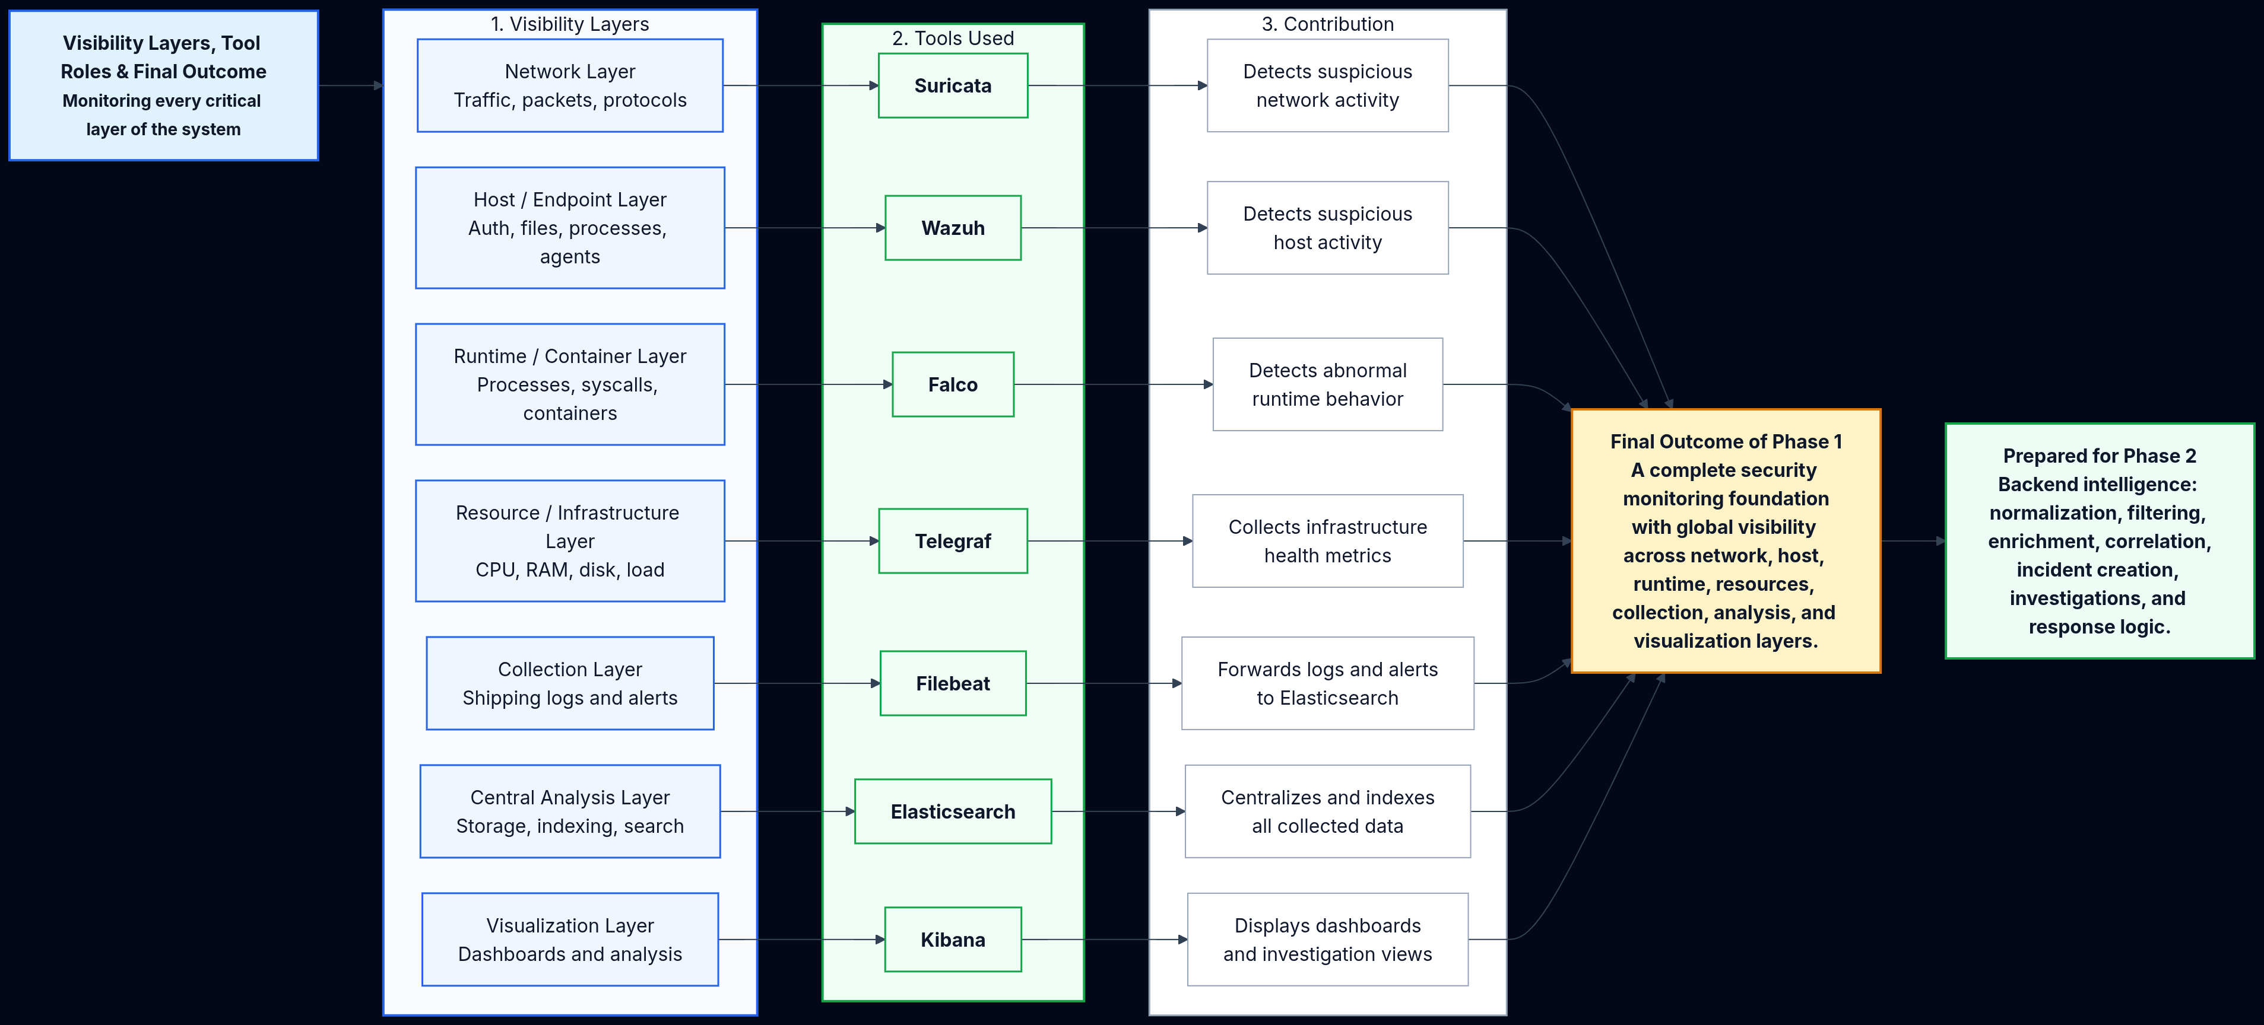
PHASE 1 — MONITORING
PHASE 1 FINAL OUTCOME
FINAL OUTCOME
This layered architecture removes monitoring blind spots.
Instead of watching only one part of the infrastructure, the system observes:
• Network traffic
• Host activity
• Runtime behavior
• Resource health
All centralized and visualized together. That is what gives the project global system visibility.
→ Ready for Phase 2 & 3
10

Slide 11
03
PHASE 2: CLOUD INFRASTRUCTURE
Deploying the SOC platform on Huawei Cloud
11

Slide 12
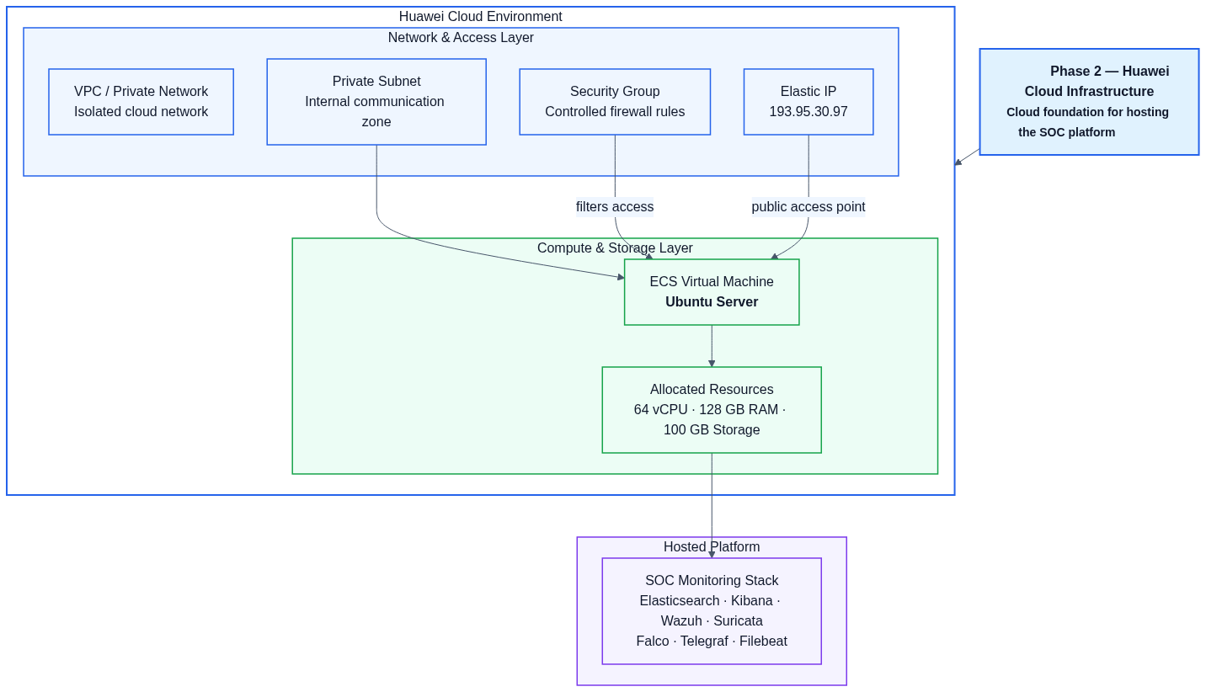
PHASE 2 — CLOUD
HUAWEI CLOUD ENVIRONMENT
ECS VM SPECIFICATIONS
64 vCPU · 128 GB RAM · 100 GB Storage
OS: Ubuntu Server
Public IP: 193.95.30.97
VPC / Private Network
Private Subnet · Security Group
SOC MONITORING STACK
Elasticsearch · Kibana · Wazuh
Suricata · Falco · Telegraf
Filebeat · Docker Runtime
Storage covers OS, ES indices, Wazuh data, Suricata logs, Filebeat state, Telegraf metrics, Docker files, and configurations.
12

Slide 13
PHASE 2 — CLOUD
SECURITY GROUP STRATEGY & INTEGRATION
Service | Port | Exposure Recommendation
SSH | 22 | Allow only from admin IP
Kibana | 5601 | Restrict to admin / VPN / public only if required
Elasticsearch | 9200 | Do not expose publicly
Wazuh Events | 1514 | Allow only if external agents are used
Wazuh Registration | 1515 | Allow only if external agents are used
Falcosidekick | 2801 | Internal only
Backend API | 8000/8001 | Restrict or expose through reverse proxy
HTTP/HTTPS | 80/443 | Use only with reverse proxy and TLS
CRITICAL PRINCIPLE
Elasticsearch must remain internal. Kibana and SSH access strictly restricted to authorized sources only.
HOW THIS SUPPORTS THE PROJECT
• Connects theoretical architecture to real operations
• Hosts the complete SOC stack securely
• Enables secure expansion in later phases
• Ubuntu ECS VM runs all monitoring tools
• Foundation for backend intelligence layer
13

Slide 14
04
PHASE 3: BACKEND INTELLIGENCE
From raw monitoring data to intelligent, verified SOC operations
14

Slide 15
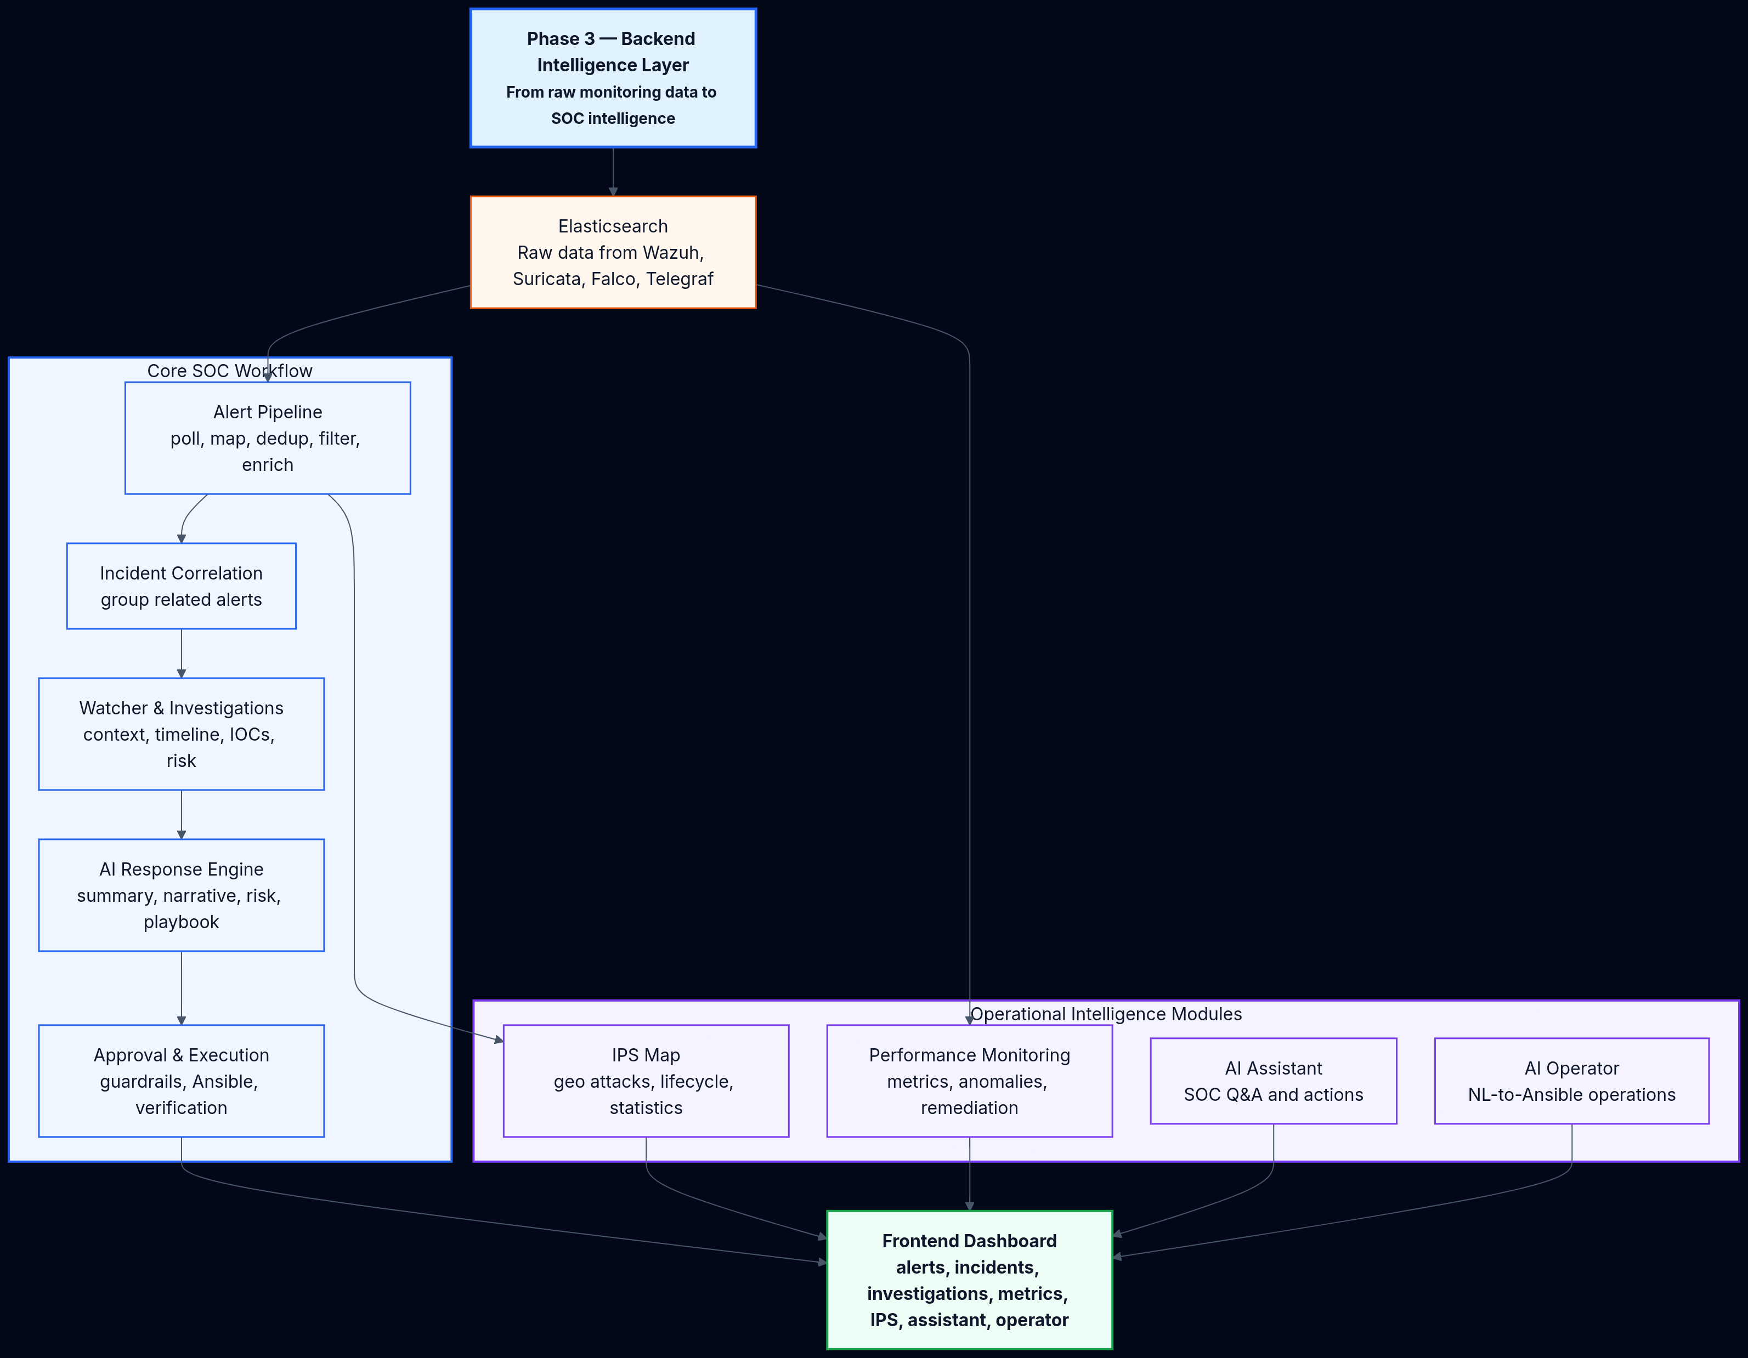
PHASE 3 — INTELLIGENCE
PHASE 3 GLOBAL OVERVIEW
After Phase 1 and Phase 2, the platform has security tools → Elasticsearch → Kibana. But Elasticsearch still contains mostly raw technical data. Phase 3 transforms that raw data into SOC intelligence.
Raw Data → Normalized Alerts → Correlated Incidents → Investigations → AI Analysis → Playbooks → Approval → Execution → Verification → Archives → Dashboards
15

Slide 16
PHASE 3 — INTELLIGENCE
STEP 1 — ALERT INGESTION & ENRICHMENT
Goal: Continuously read new security data from Elasticsearch and transform into clean, enriched alerts.
ES SOURCES
PIPELINE STAGES
OUTPUT
wazuh-alerts-*
suricata-*
falco-events-*
filebeat-*
telegraf-*
Poll ES → Source Mappers
Deduplication → Filtering
Enrichment (GeoIP + MITRE)
Campaign Tracking → Whitelist
SQLite Persistence
Clean normalized alerts
Visible in /alerts and /ips
Ready for incident correlation
WebSocket broadcast updates
16

Slide 17
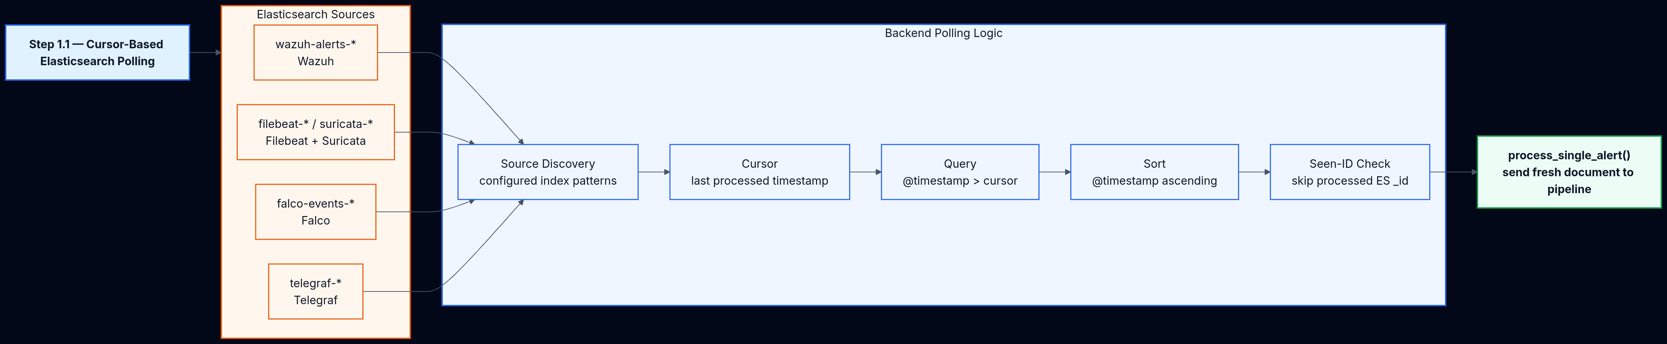
PHASE 3 — INTELLIGENCE
STEP 2 — POLLING & ALERT TRANSFORMATION
CURSOR-BASED ELASTICSEARCH POLLING
RAW DOCUMENT TO CLEAN ALERT
Source Discovery → Cursor (last timestamp) → Query (@timestamp > cursor) → Sort ascending → Seen-ID Check → process_single_alert() sends fresh documents to the pipeline.
Raw ES Document → Source Mappers (Wazuh, Suricata, Falco, Filebeat, Generic) → Common Alert Model → Alert Processing → Clean SOC Alert ready for incident correlation.
17

Slide 18
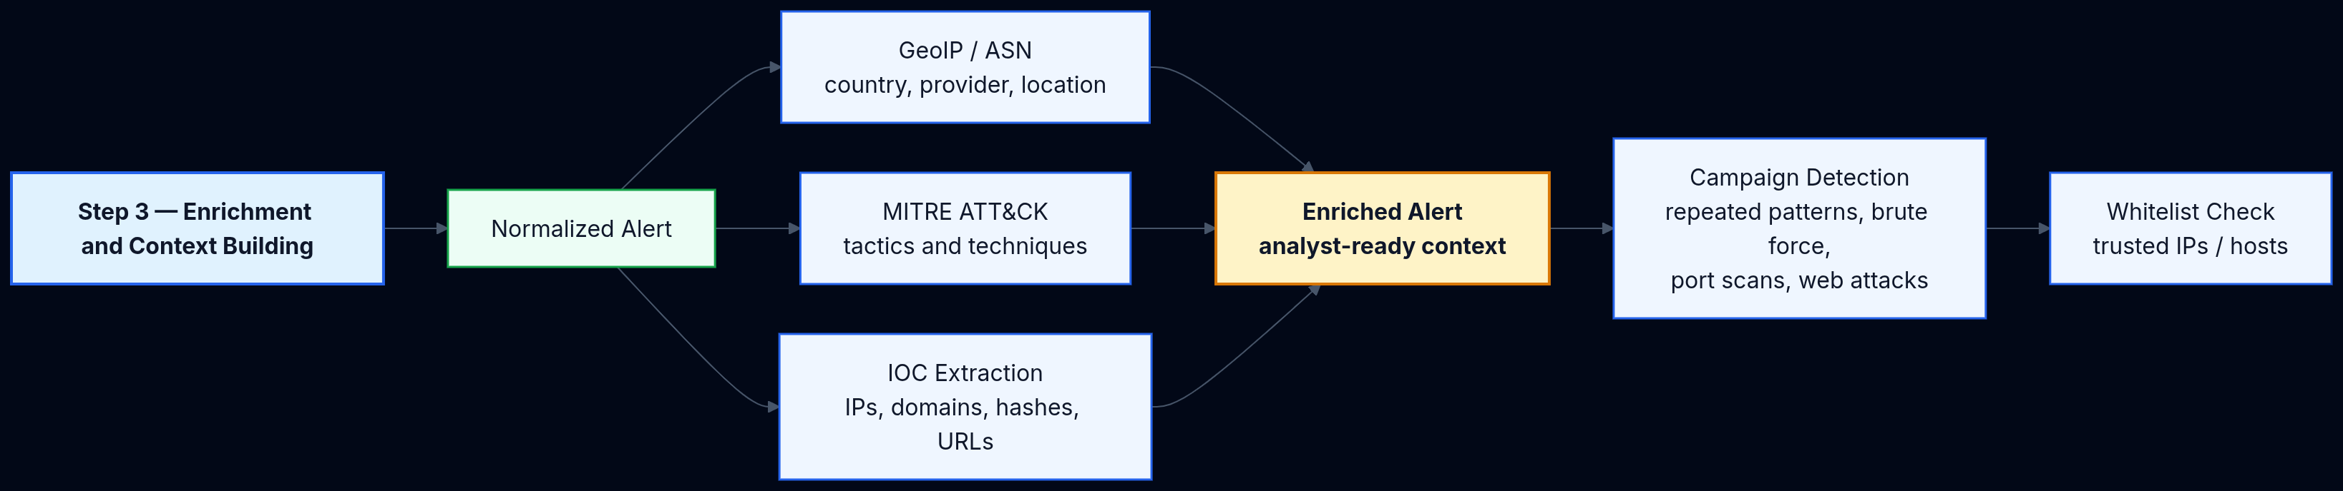
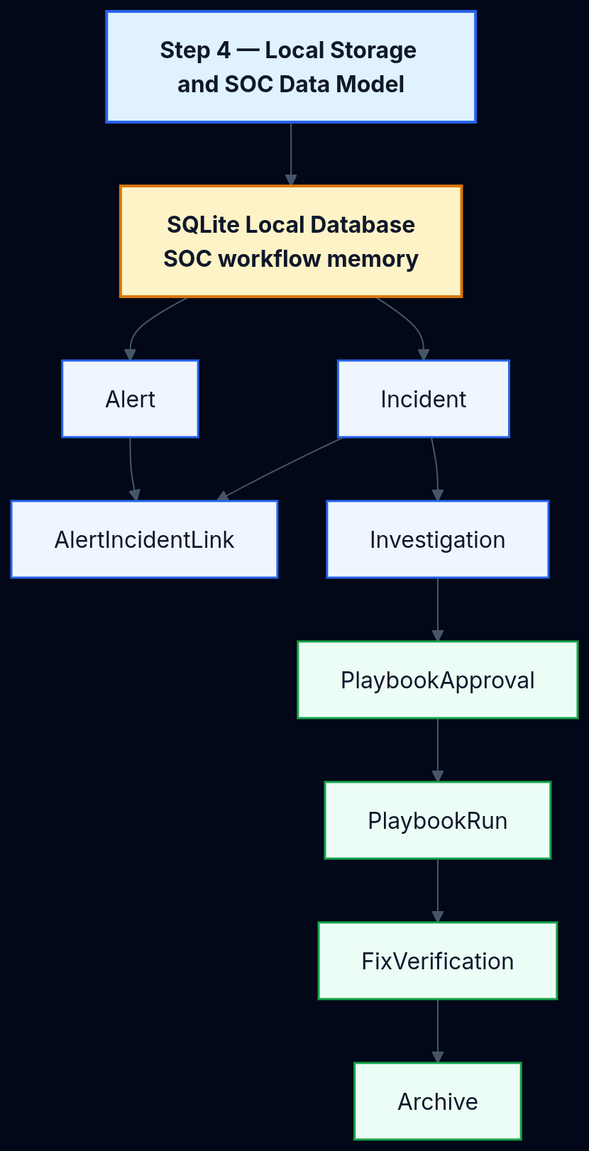
PHASE 3 — INTELLIGENCE
STEP 3 — ENRICHMENT & DATA MODEL
ENRICHMENT & CONTEXT BUILDING
LOCAL STORAGE & SOC DATA MODEL
Normalized Alert → GeoIP/ASN → MITRE ATT&CK mapping → IOC Extraction → Campaign Detection → Whitelist Check → Enriched Alert with analyst-ready context.
SQLite with SQLAlchemy async ORM. Core tables: Alert, Incident, AlertIncidentLink, Investigation, PlaybookApproval, PlaybookRun, FixVerification, Archive.
18

Slide 19
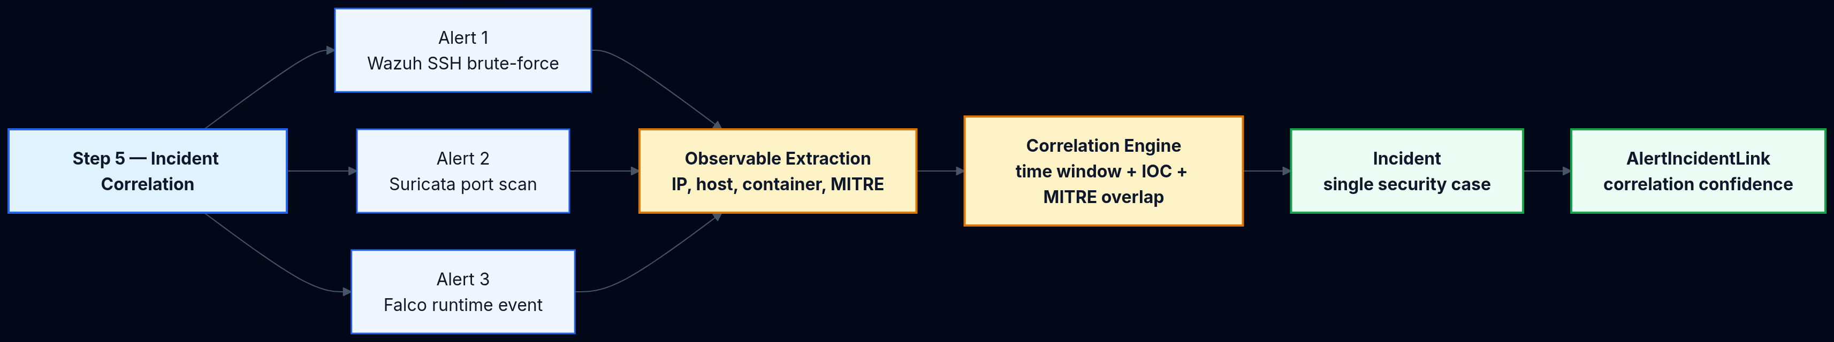
PHASE 3 — INTELLIGENCE
STEP 4 — INCIDENT CORRELATION
Goal: Correlate related alerts into incidents using shared observables, attack patterns, and time windows.
CORRELATION SIGNALS
EXAMPLE
• Source IP — same attacker origin
• Hostname / Container ID — same target
• Attack pattern & MITRE tactics
• Kill-chain progression & time window
Suricata port scan + Wazuh SSH brute force from same IP + Falco shell activity = One stronger incident with higher confidence
19

Slide 20
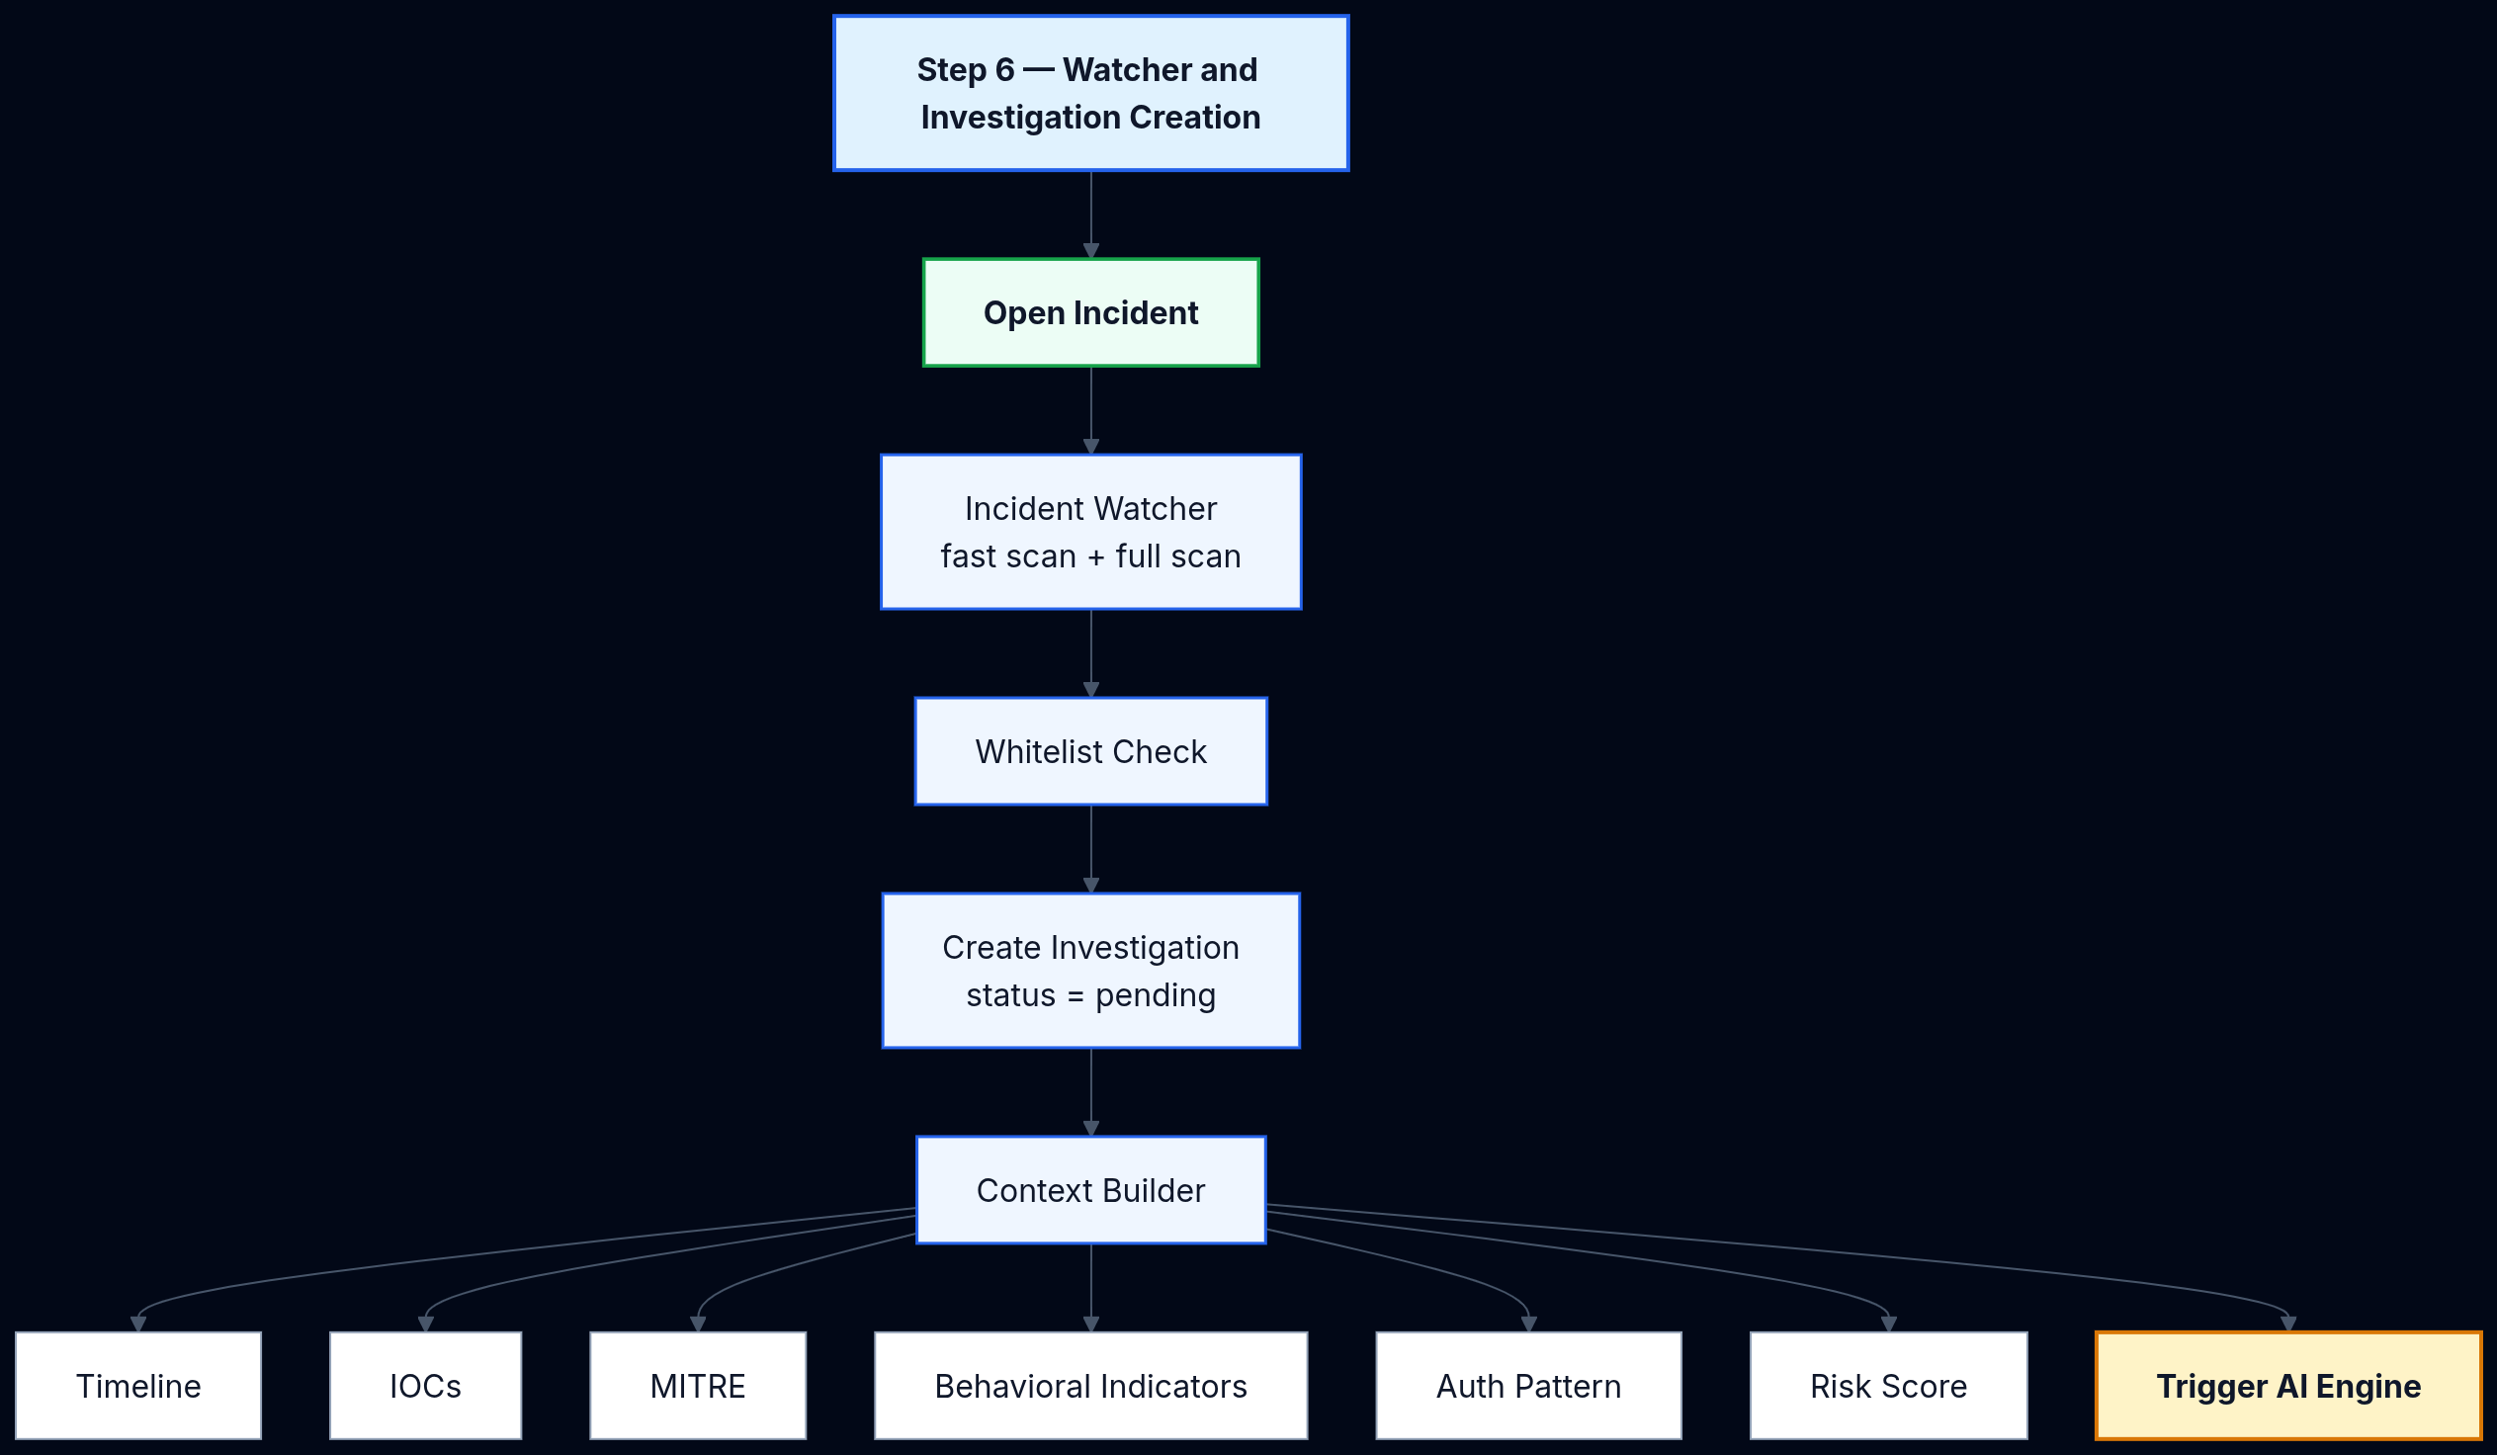
PHASE 3 — INTELLIGENCE
STEP 5 — WATCHER & INVESTIGATION
Goal: Create an investigation context for each open incident, then trigger the AI engine.
INVESTIGATION CONTEXT
• Linked alerts & full timeline
• Source & destination IPs
• Hostnames, usernames, processes
• Domains and network flows
• MITRE tactics & techniques
• Behavioral patterns
• Risk score & attack type
• Auth pattern analysis
• → Triggers AI Engine
20

Slide 21
PHASE 3 — INTELLIGENCE
STEP 6 — AI RESPONSE ENGINE
Goal: Analyze investigations and propose remediation plans using multi-provider LLM routing.
Input
Investigation context
Timeline, IOCs, MITRE
Risk score
Processing
Circuit Breaker check
Prompt Builder
LLM Provider routing
Providers
Ollama (local)
Google Gemini
OpenRouter / NVIDIA NIM
Output
Summary & Narrative
Risk assessment
Playbook YAML
Auto-approval check
Important: The system does not blindly execute. Output goes through approval and validation before any action is taken.
21

Slide 22
PHASE 3 — INTELLIGENCE
STEP 7 — APPROVAL, EXECUTION & VERIFICATION
Goal: The backend never blindly executes. Controlled remediation with full audit trails.
APPROVAL TYPES
EXECUTION CONTROLS
FIX OUTCOMES
• Manual — analyst reviews
• Auto-approved — low-risk only
• Blocked — critical / high-risk
• Playbook validation
• SSH pre-check
• Whitelist protection
• Execution logging
• likely_fixed — success, no new alerts
• not_fixed — alerts continue
• inconclusive — unclear signals
• playbook_failed_but_quiet
22

Slide 23
PHASE 3 — INTELLIGENCE
STEP 8 — PERFORMANCE MONITORING & REMEDIATION
Goal: Detect infrastructure anomalies and auto-remediate with the same controlled workflow.
MONITORED METRICS
• CPU usage_iowait
• CPU usage_user
• CPU usage_system
• Memory used_percent
• Disk used_percent
• Network bytes_recv
• Network bytes_sent
• System load1
• Process CPU usage
• Process memory RSS
• Netstat TCP established
Flow:
ES metrics → Poller → Redis baselines → Anomaly Detector → Root Cause → Dynamic Playbook → Approval → Ansible → Verification
23

Slide 24
PHASE 3 — INTELLIGENCE
STEP 9 — IPS ATTACK VISUALIZATION
Goal: Geo-enriched attack mapping with world map visualization.
PROCESSING FLOW
ATTACK CATEGORIES
LIFECYCLE STATES
Local SQLite + upstream alerts → Deduplicate (source IP + time window) → GeoIP Resolve (country, city, lat/lon, ASN) → Categorize → Lifecycle → /ips World Map
• Brute-force
• Web attack
• Reconnaissance
• Malware / DoS / C2
• Active
• Investigating
• Mitigated / Blocked
24

Slide 25
PHASE 3 — INTELLIGENCE
STEP 10 — AI ASSISTANT & AI OPERATOR
AI ASSISTANT — CONVERSATIONAL ANALYST
AI OPERATOR — NL TO ANSIBLE
Question → Keyword Extraction → Deep Entity Fetch → Context Prompt → LLM Answer → Suggested Actions → Conversation Storage.
Actions: Approve, decline, execute, archive investigations.
NL Request → Reasoning → Template Match or LLM Playbook → OperatorRun → Approval Gate → Ansible Execution → Structured Result.
Templates: RAM, disk, CPU, ports, services, Docker, packages.
25

Slide 26
05
SUMMARY & OUTCOMES
What the complete platform delivers
26

Slide 27
SUMMARY
COMPLETE PLATFORM SUMMARY
1
MONITORING
2
CLOUD
3
INTELLIGENCE
Complete visibility across network, host, runtime, and infrastructure layers. Suricata, Wazuh, Falco, Telegraf, Filebeat, Elasticsearch, Kibana.
Huawei Cloud deployment with VPC, Security Groups, ECS VM (64 vCPU / 128 GB RAM). Secure access controls and scalable foundation.
10 steps from raw ES data to SOC ops: ingestion, transformation, enrichment, correlation, investigation, AI analysis, approval, execution, verification.
OPERATIONAL MODULES
Performance Monitoring · IPS Attack Visualization · AI Assistant · AI Operator
The platform transforms raw monitoring data into actionable SOC intelligence,
operational visibility, and controlled response workflows.
27

Slide 28
THE PLATFORM NOW THINKS BEFORE IT ACTS
From passive monitoring to intelligent SOC operations
A complete security operations center that sees everything, understands patterns, and responds with control.
28

